Slide 1
Week 1 of Capstone Project
Fire Detection Using Surveillance Camera on Roads
Submitted by: Akash Papnai, Vipul Chandra
Submitted to: Prof. Deepak Singh
IIIT Lucknow

Slide 2
Data Gathering
As discussed earlier in Capstone Timeline, this week will be purely focused on Data Gathering.
In this ppt, we will show that where from where we collected our data for this project.

Slide 3
Kaggle
The most important source for this project is www.kaggle.com .
It supplies most of the relevant information and images which is required for this project.

Slide 4
Google Images
Other sources are images.google.com
This website provides additional photos to be added to dataset to make it more accurate.

Slide 5
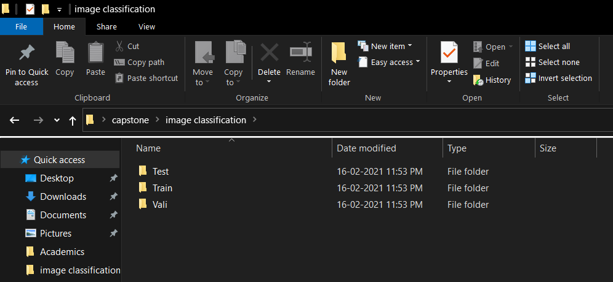
About Data

Slide 6
Difference between each Data Item
Train Data:- This data is used while Training the ML model
Test Data:- This data is used for testing the results.
Vali Data:- This data is just to validate the training data sporadically.

Slide 7
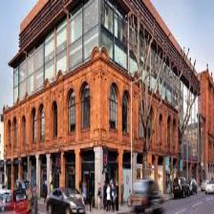
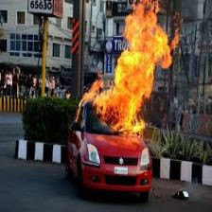
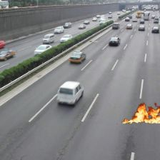


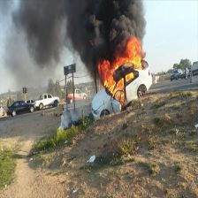
Pictures of Train, Test and Vali Data
Non Fire
Fire
Fire
Non Fire
Non Fire
Fire
Train
Test
Vali

